Slide 1

Go, change the world
RV College of
Engineering
Department of Master of Computer Applications
20MCA 42 –Technical Seminar
Near Field Communication
Under the Guidance
of
Dr. Jasmine K.S
Associate Professor
Department of Master of Computer Application
Ishita Sarkar
(1RV20MC028)

Slide 2

Go, change the world
RV College of
Engineering
Agenda
Introduction
Literature Survey
Summary of Literature Survey
Technical Relevance
Block diagram for the proposed approach/solution
Key Competitors
Sustainability and Societal Concerns
Tools and Technologies
Proposed Work
Conclusion
References

Slide 3
RV College of
Engineering
Introduction
Go, change the world
Near-field communication (NFC) is a set of communication protocol that enables communication between two electronic devices
Provides communication over a distance of upto 4 cm (1¹⁄₂ in) or less
NFC offers a low-speed connection through a simple setup
Can be used to bootstrap more-capable wireless connections.
NFC is best used to securely transfer a range of data over short distances

Slide 4
Go, change the world
Application Area:
Educational Institutions
Payment Gateways
Data Transfer

Slide 5
Go, change the world
Justification:
NFC is a growing technology that has made its way through our day-to-day life, NFC can be for quick payments and even to transfer data from one device to another. NFC can make making college payments easier and quicker, it can also lessen the manual work required during taking attendance which is not only time consuming but is difficult to cope up with.

Slide 6
Go, change the world
Technological developments in the area of study chosen;
NFC Enabled Smartphones (Gpay, Apple pay)
NFC Enables Cards
NFC Enabled Printers

Slide 7
Go, change the world
RV College of
Engineering
Literature Review
S No | Author and Paper title | Details of Publication | Summary of the Paper
1 | Martin Erb; Christian Steger; MartinTroyer;Josef Preishuber-Pflügl A Framework for Automated NFC Interoperability Test Systems | Published in: IEEE Journal of Radio Frequency Identification ( Volume: 5, Issue: 4, Dec. 2021) Page(s): 357 - 367 Date of Publication: 30 June 2021 INSPEC Accession Number: 21299135 DOI: 10.1109/JRFID.2021.3093589 Publisher: IEEE | The framework presented in this article allows gathering additional information about the NFC communication, improves the test results, and decreases time-consuming manual debugging sessions in case of any error.

Slide 8
Go, change the world
RV College of
Engineering
Literature Review
S No | Author and Paper title | Details of Publication | Summary of the Paper
2 | Bander A. Alzahrani , Khalid Mahmood , and Saru Kumari Lightweight Authentication Protocol for NFC Based Anti-Counterfeiting System in IoT Infrastructure | Received April 6, 2020, accepted April 16, 2020, date of publication April 21, 2020, date of current version May 6, 2020. IEEE Access | In this it introduces a novel authentication protocol for anti-counterfeited drugs systems based on Internet of Things (IoT) to help checking the validity of drugs ‘‘unit dosage’’.

Slide 9
Go, change the world
RV College of
Engineering
Literature Review
S No | Author and Paper title | Details of Publication | Summary of the Paper
3 | Albatul Albattah; Yara Alghofaili; Salim Elkhediri NFC Technology: Assessment Effective of Security towards Protecting NFC Devices & Services | Published in: 2020 International Conference on Computing and Information Technology (ICCIT-1441) Date of Conference: 9-10 Sept. 2020 Date Added to IEEE Xplore: 23 November 2020 INSPEC Accession Number: 20197922 DOI: 10.1109/ICCIT-144147971.2020.9213758 Publisher: IEEE Conference Location: Tabuk, Saudi Arabia | The basic objective of this paper is to discuss NFC in general and compare this technology with RFID.

Slide 10
Go, change the world
RV College of
Engineering
Literature Review
S No | Author and Paper title | Details of Publication | Summary of the Paper
4 | Stanyo Kolev Designing a NFC system | Published in: 2021 56th International Scientific Conference on Information, Communication and Energy Systems and Technologies (ICEST) Date of Conference: 16-18 June 2021 Date Added to IEEE Xplore: 28 July 2021 INSPEC Accession Number: 20942963 DOI: 10.1109/ICEST52640.2021.9483482 Publisher: IEEE Conference Location: Sozopol, Bulgaria | The article proposes an NFC system with NXP PN 532 chip, designed and implemented an antenna for 13.56 MHz. NFC technology is entering the Bulgarian market and is developing at a very fast pace.

Slide 11
Go, change the world
RV College of
Engineering
Literature Review
S No | Author and Paper title | Details of Publication | Summary of the Paper
5 | Neeraj Kumar Singh Near-field Communication (NFC) An Alternative to RFID in Libraries | Information Technology and Libraries Singh, N. K. (2020). Near-field Communication (NFC). Information Technology and Libraries, 39(2). https://doi.org/10.6017/ital.v39i2.11811 | The aim of this paper is to explore NFC technology and its applications in modern era. The paper will discuss potential use of NFC in the advancement of traditional library management system.

Slide 12
Go, change the world
RV College of
Engineering
Literature Review
S No | Author and Paper title | Details of Publication | Summary of the Paper
6 | Muhammad Luthfi Hamzah, Syarif Kasim, Riau Yenny, Desnelita Astri, Ayu Purwati, Sekola Tinggi, Ilmu Ekonomi, Riau Ermina Rusilawati A review of Near Field Communication technology in several areas | Revista ESPACIOS ISSN 0798 1015 Vol. 40 (Nº 32) Year 2019 | In this paper, 52 journals have been reviewed and the papers have been classified into categories based on the areas of NFC implemented such as automotive, services education, public health care, indoor navigation system, payment system, public transportation, retail industries, smart posters and tourisms.

Slide 13
Go, change the world
RV College of
Engineering
Literature Review
S No | Author and Paper title | Details of Publication | Summary of the Paper
7 | Zhonglin Cao ,Ping Chen, Zhong Ma,Sheng, Li,Xingxun, GaoORCID,Rui-xin, Wu,Lijia Pan, andYi Shi Near-Field Communication Sensors | Sensors 2019, 19(18), 3947; https://doi.org/10.3390/s19183947 Received: 30 July 2019 / Revised: 3 September 2019 / Accepted: 7 September 2019 / Published: 12 September 2019 Multidisciplinary Digital Publishing Institute(MDPI) | This paper summarizes recent progress in near field communication sensors, including the development of materials and device design and their applications in wearable personal healthcare devices. The opportunities and challenges in near-field communication sensors are discussed in the end.

Slide 14
Go, change the world
RV College of
Engineering
Literature Review
S No | Author and Paper title | Details of Publication | Summary of the Paper
8 | Marllene Daneti An NFC-based method for rapid identification of teaching resources | Published in: 2016 IEEE Global Engineering Education Conference (EDUCON) Date of Conference: 10-13 April 2018 Date Added to IEEE Xplore: 23 May 2018 Electronic ISSN: 2165-9567 INSPEC Accession Number: 16005222 DOI: 10.1109/EDUCON.2016.7474556 Publisher: IEEE Conference Location: Abu Dhabi, United Arab Emirates | This paper proposes a method of organizing the available material resources based on the Near Field Communication (NFC) technology, by which teachers can rapidly identify the required physical parts and approach practically in real time a wide range of information on the topic, leading to significant streamlining of his work.

Slide 15
Go, change the world
RV College of
Engineering
Literature Review
S No | Author and Paper title | Details of Publication | Summary of the Paper
9 | Giles Tewkesbury; David Sanders; Malik Haddad; Peter Omoarebun; Alexander Gegov Creation of a NFC Reading System for University Attendance Monitoring with Accessibility Considerations for Powered Wheelchair Users | Published in: 2020 IEEE 10th International Conference on Intelligent Systems (IS) Date of Conference: 28-30 Aug. 2020 Date Added to IEEE Xplore: 18 September 2020 ISBN Information: Print on Demand(PoD) ISSN: 1541-1672 INSPEC Accession Number: 19986282 DOI: 10.1109/IS48319.2020.9199971 Publisher: IEEE Conference Location: Varna, Bulgaria | This paper considers the hardware and software implementation of a Near-Field Communication (NFC) reading system which was used to collect student attendance.

Slide 16
Go, change the world
RV College of
Engineering
Literature Review
S No | Author and Paper title | Details of Publication | Summary of the Paper
10 | Janea Dixon; Abdel-shakour Abuzneid An NFC Based Student Attendance Tracking/Monitoring System Using an IoT Approach | Published in: 2020 International Conference on Computational Science and Computational Intelligence (CSCI) Date of Conference: 16-18 Dec. 2020 Date Added to IEEE Xplore: 23 June DOI: 10.1109/CSCI51800.2020.00201 Publisher: IEEE Conference Location: Las Vegas, NV, USA | In this paper, implementation of a system takes place that incorporates NFC, cloud-based services, and a web interface for end-users. The design introduces a one-to-one method using a student ID with an RFID tag to RFID reader located at each desk.

Slide 17
Go, change the world
RV College of
Engineering
Literature Review
S No | Author and Paper title | Details of Publication | Summary of the Paper
11 | K.Muthuselvi , E.Maheswari , N.Selvarani Attendance Monitoring System Using NFC | Website: www.ijareeie.com Indian Journal of Advancd Research in Electrical, Electronics and Instumentation Engineering Vol. 8, Issue 3, March 2019 | Attendance at gate through face recognition mapped with attendance which is generated through NFC. This mapping is used to avoid fake attendance and increase accuracy.

Slide 18
Go, change the world
RV College of
Engineering
Literature Review
S No | Author and Paper title | Details of Publication | Summary of the Paper
12 | Aqqiela Zuhra Aqqiela Zuhra Zuhedy Zay Rizal Mohd Nor International Islamic University Malaysia Mohamed Jalaldeen NFC BASED ATTENDANCE: MORE THAN JUST A TOUCH | Received 1 February 2016 Received in revised form 24 March 2016 Accepted 1 August 2016 International Islamic University Malaysia rizalmohdnor@iium.edu.my | In this study, university smart environment is implemented using NFC for attendance monitoring system to reduce the need of tedious tasks. The application involves several different concerns in access control and managing physical and virtual components.

Slide 19
Go, change the world
RV College of
Engineering
Summary of the Literature Survey
The paper conveys the ways used to improve the efficiency of the NFC
The study also shows that all the devices or application developed using NFC are not cost effective for example; NFC chips are installed in all the desk to make the desk NFC enabled, thus installing NFC ships in all the desk will be costly
The other NFC model which was IoT based is also not effective cost wise as everyone cannot afford the IoT mechanism
The present models which are available are suitable for classrooms or universities which has a small group of students
Remaining papers are about what NFC is and where it is used or can be used but they do not provide any system to implement anything new

Slide 20
Go, change the world
Model/Methodology Proposed
The method proposed is that an NFC enabled watch will be used
The unique code of the watch will be scanned by a nearby NFC sensor which will then match the code with database
Once it is confirmed that the unique code belongs to the watch holder the application will mark the student present
At the end of the class hour the students who didn’t scan the watches will be marked absent

Slide 21
Go, change the world
RV College of
Engineering
Technical Relevance
Wireless Charging
Wireless Transmission
Wireless Payments
Wireless Authentication

Slide 22
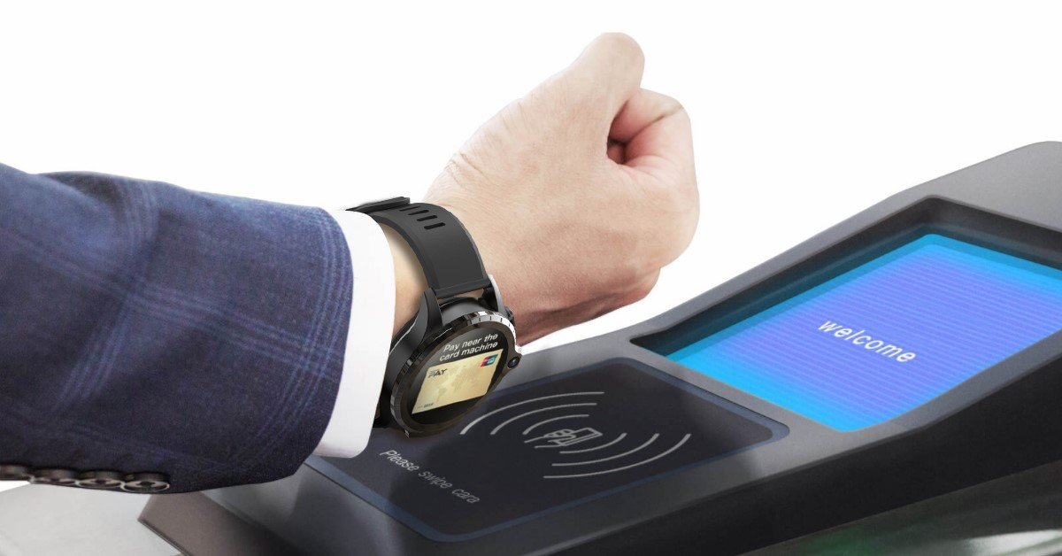
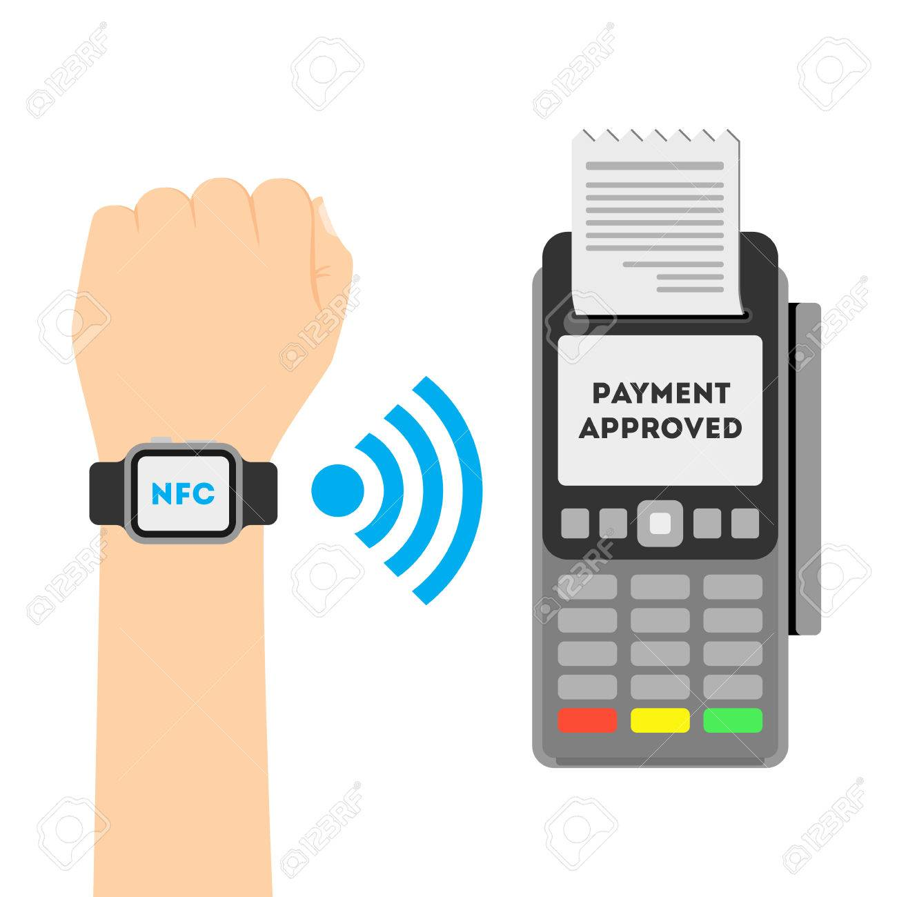

Go, change the world
RV College of
Engineering
Block diagram
Transmission between 2 NFC devices commences
Scans the watch code through NFC Sensor
NFC Sensor
Sends scanned code to database
Receives the output whether code matches or nor
NFC watch and NFC Sensor
Student USN Database
Checks whether the code scanned matched the one on database
Depending on the results received mark student present, if the watch is not scanned for the attendance or delay in scanning (after class is over) mark absent
One can even make payments using the same model, the only difference it will deduct money from the bank account through the card details saved and mark in the database as payment successful
ATTENDANCE MONITORING USING NFC WATCH

Slide 23
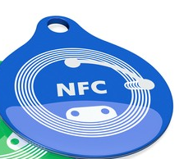
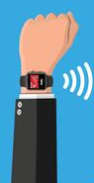
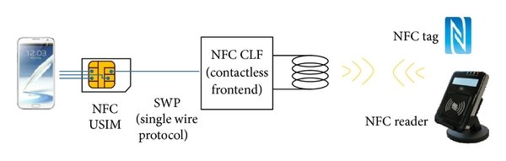
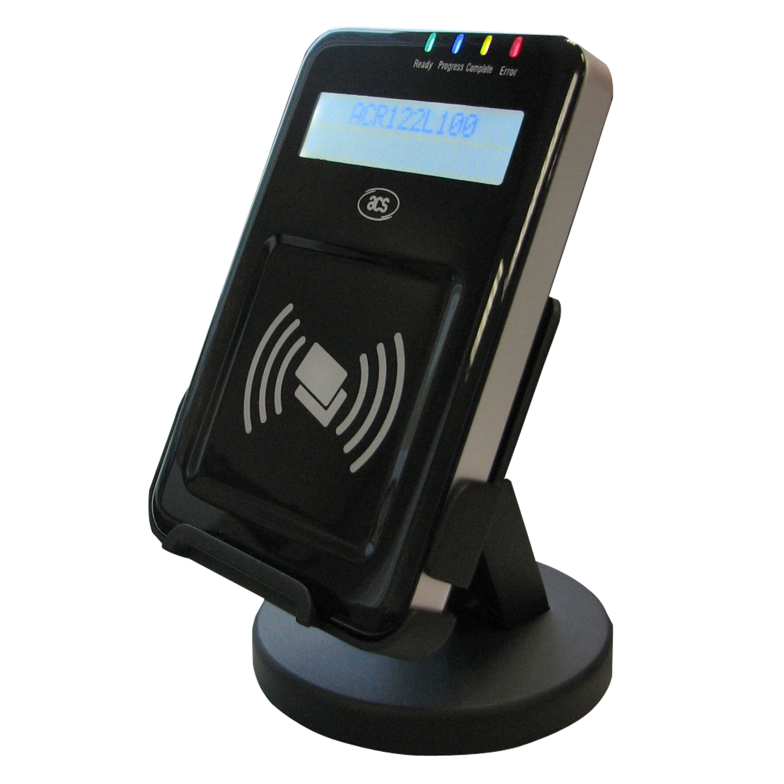
Go, change the world
RV College of
Engineering
Proposed Solution
NFC Tag
NFC CLF
(contactless frontend)
SWP
(single wire protocol)
NFC USIM
NFC Reader

Slide 24
Go, change the world
RV College of
Engineering
Key competitors
Some of the key competitors are:
Titan Watches :
According to the press release issued by the bank, SBI account holders can tap their Titan Pay watch on contactless payment POS machines without the need of swiping or inserting their SBI bank card

Slide 25
Go, change the world
Xiaomi Watches :
Easy cashless payment on your wristPartnering with MasterCard Xiaomi Watch S1 supports NFC cashless payment
Bank of Baroda :
A Smart Vital Health Watch. The wearable smart watch is designed to ensure seamless digital payments for its consumers

Slide 26
Go, change the world
Apple Watches :
Since the Apple Watch 7 has an NFC chip, you can use it to pay at any place with contactless checkout

Slide 27
Go, change the world
RV College of
Engineering
Sustainability
Benefits of NFC for Individuals
Contactless Payments
Contactless payment is a secure payment method using a debit or credit card, smartcard, or another payment device by using RFID technology and near-field communication

Slide 28
Go, change the world
RV College of
Engineering
Sustainability
Information Sharing :
Information sharing describes the exchange of data between various organizations, people and technologies
Transportation :
The passenger can make the NFC facilitated payment of credit/debit cards, pre-paid tickets, traveller passes etc from the smartphone

Slide 29
Go, change the world
RV College of
Engineering
Sustainability
Social Networking :
Near Field Communication (NFC) allows wireless communication between two electronic devices close to each other
Health Care :
NFC tags are particularly useful in hospital settings to monitor supplies and resources

Slide 30
Go, change the world
Benefits of NFC for Businesses
Staff Communication :
Staff Communication NFC tags allows employees to check in at their current locations and record time spent on the clock and time spent on break

Slide 31
Go, change the world
Real-Time Updates :
One can get real-time updates on their employees and the work that is needed to be done
Improved Customer Service :
NFC payments help speed up checkout lines, increasing customer satisfaction with your business

Slide 32
Go, change the world
RV College of
Engineering
Tools and Technologies
Software Requirements For Mobile Application:
Android Studio
Payment Gateway Software/API
Software Requirements For Watch:
Wear OS

Slide 33
Go, change the world
RV College of
Engineering
Tools and Technologies
Hardware Requirements For Application:
Any Android device
Hardware Requirements For Watch:
NFC Chip

Slide 34
Go, change the world
RV College of
Engineering
Tools and Technologies
NFC Chips:
NFC chips are the base of our proposed system
The NFC chip will be installed in the watch and an another NFC based reader will be used to scan the unique code
Once the NFC reader reads the code it will check the code with the one stored in the database
After authentication it marks the attendance of the student
The proposed method can also be used for contactless payments where the students can make payments related to college
NFC makes payments and attendance monitoring quicker and easier

Slide 35
Go, change the world
RV College of
Engineering
Conclusion
NFC is an extremely simple and convenient technology because the data exchange can be done by just bringing two NFC-enabled devices together
It is interactive and secure and does not require any special software to run on
It also does not require any manual configuration or settings which makes it easier for consumers
This technology has the limitation that it can be operated only with devices under a short range and has a very less data transfer rate

Slide 36
Go, change the world
RV College of
Engineering
References
Martin Erb; Christian Steger; Martin Troyer; Josef Preishuber-Pflügl, A Framework for Automated NFC Interoperability Test Systems, Published in: IEEE Journal of Radio Frequency Identification ( Volume: 5, Issue: 4, Dec. 2021) Page(s): 357 - 367 Date of Publication: 30 June 2021 INSPEC Accession Number: 21299135 DOI: 10.1109/JRFID.2021.3093589 Publisher: IEEE.
Bander A. Alzahrani, Khalid Mahmood, and Saru Kumari, Lightweight Authentication Protocol for NFC Based Anti-Counterfeiting System in IoT Infrastructure, Received April 6, 2020, accepted April 16, 2020, date of publication April 21, 2020, date of current version May 6, 2020, IEEE Access
Albatul ALBATTAH; Yara ALGHOFAILI; Salim ELKHEDIRI, NFC Technology: Assessment Effective of Security towards Protecting NFC Devices & Services, Published in 2020 International Conference on Computing and Information Technology (ICCIT-1441) Date of Conference: 9-10 Sept. 2020 Date Added to IEEE Xplore: 23 November 2020, INSPEC Accession Number: 20197922 DOI: 10.1109/ICCIT-144147971.2020.9213758 Publisher: IEEE Conference Location: Tabuk, Saudi Arabia
Stanyo Kolev, Designing an NFC system, Published in 2021 56th International Scientific Conference on Information, Communication and Energy Systems and Technologies (ICEST) Date of Conference: 16-18 June 2021 Date Added to IEEE Xplore: 28 July 2021 INSPEC Accession Number: 20942963 DOI: 10.1109/ICEST52640.2021.9483482 Publisher: IEEE, Conference Location: Sozopol, Bulgaria
Neeraj Kumar Singh, Near-field Communication (NFC) An Alternative to RFID in Libraries, Singh, N. K. (2020). Near-field Communication (NFC). Information Technology and Libraries, 39(2). https://doi.org/10.6017/ital.v39i2.11811.
Muhammad Luthfi Hamzah, Syarif Kasim, Riau Yenny, Desnelita Astri, Ayu Purwati, Sekola Tinggi, Ilmu Ekonomi, Riau Ermina Rusilawati, A review of Near Field Communication technology in several areas, Revista ESPACIOS. ISSN 0798 1015, Vol. 40, the Year 2019
Zhonglin Cao ,Ping Chen,, Zhong Ma,Sheng, Li,Xingxun, GaoORCID,Rui-xin, Wu,Lijia Pan, andYi Shi,Near-Field Communication Sensors,Sensors 2019, 19(18), 3947;, https://doi.org/10.3390/s19183947 Received: 30 July 2019 / Revised: 3 September 2019 / Accepted: 7 September 2019 / Published: 12 September 2019,MDPI
Marllene DanetiAn NFC-based method for rapid identification of teaching resources, Published in 2016 IEEE Global Engineering Education Conference (EDUCON), Date of Conference: 10-13 April 2018, Date Added to IEEE Xplore: 23 May 2018, ISBN Information: Electronic ISSN: 2165-9567, INSPEC Accession Number: 16005222, DOI: 10.1109/EDUCON.2016.7474556, Publisher: IEEE, Conference Location: Abu Dhabi, United Arab Emirates

Slide 37
Go, change the world
[9]Giles Tewkesbury; David Sanders; Malik Haddad; Peter Omoarebun; Alexander Gegov, Creation of a NFC Reading System for University Attendance Monitoring with Accessibility Considerations for Powered Wheelchair Users, Published in 2020 IEEE 10th International Conference on Intelligent Systems (IS) Date of Conference: 28-30 Aug. 2020 Date Added to IEEE Xplore: 18 September 2020 ISBN Information: Print on Demand(PoD) ISSN: 1541-1672 INSPEC Accession Number: 19986282 DOI: 10.1109/IS48319.2020.9199971 Publisher: IEEE Conference Location: Varna, Bulgaria
[10]Janea Dixon; Abdel-shakour Abuzneid, An NFC Based Student Attendance Tracking/Monitoring System Using an IoT Approach, Published in 2020 International Conference on, Computational Science and Computational Intelligence (CSCI) Date of Conference: 16-18 Dec. 2020 Date Added to IEEE Xplore: 23 June 2021 ISBN Information: DOI: 10.1109/CSCI51800.2020.00201 Publisher: IEEE Conference Location: Las Vegas, NV, USA
[11] K.Muthuselvi, E.Maheswari, N.Selvarani, Attendance Monitoring System Using NFC, Website: www.ijareeie.com Vol. 8, Issue 3, March 2019
[12] Aqqiela Zuhra Aqqiela Zuhra Zuhedy Zay Rizal Mohd Nor International Islamic University Malaysia Mohamed Jalaldeen NFC BASED ATTENDANCE: MORE THAN JUST A TOUCH, Received 1 February 2016, Received in revised form 24 March 2016 Accepted 1 August 2016 *Corresponding author rizalmohdnor@iium.edu.my
[13] Nahar Sunny Suresh Shobha; Kajarekar Sunit Pravin Aruna; Manjrekar Devesh Parag Bhagya el at., NFC and NFC payments: A review, Published in: 2016 International Conference on ICT in Business Industry & Government (ICTBIG) Date of Conference: 18-19 Nov. 2016, Date Added to IEEE Xplore: 06 April 2017, INSPEC Accession Number: 16792045, DOI: 10.1109/ICTBIG.2016.7892683, Publisher: IEEE, Conference Location: Indore, India
[14] Jorma Ylinen; Mikko Koskela; Lari Iso-Anttila; Pekka Loula, Near Field Communication Network Services, Published in: 2009 Third International Conference on Digital Society, Date of Conference: 1-7 Feb. 2009, Date Added to IEEE Xplore: 13 February 2009, INSPEC Accession Number: 10474674, DOI: 10.1109/ICDS.2009.43, Publisher: IEEE, Conference Location: Cancun, Mexico
[15] Busra Ozdenizci; Mehmet N. Aydin; Vedat Coskun; Ok Kerem, Design science in NFC research, Published in: 2010 International Conference for Internet Technology and Secured Transactions, Date of Conference: 8-11 Nov. 2010, Date Added to IEEE Xplore: 30 December 2010, INSPEC Accession Number: 11706488, Publisher: IEEE, Conference Location: London, UK

